Slide 1
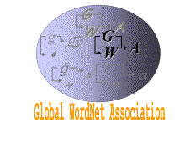
Semantic Feature Structure Extraction from Documents Based on Extended Lexical Chains
Global WordNet Conference 2018 (GWC)
Terry Ruas and William Grosky
University of Michigan - Dearborn
Singapore
January 2018

Slide 2
Agenda
Introduction
Motivation
Objectives
Possible solutions
Context
Background
WordNet
Current approaches
Methodology
Experiments
Discussions and Future Work

Slide 3
Motivation
…CAR….CAR…CAR….CAR…. …CAR….CAR…CAR….CAR….
…CAR….CAR…CAR….CAR….
…CAR….CAR…CAR….CAR….
…CAR….CAR…CAR….CAR….
…CAR….CAR…CAR….CAR….
…CAR….CAR…CAR….CAR….
…AUTOMOBILE…. AUTOMOBILE …AUTOMOBILE…. AUTOMOBILE
…AUTOMOBILE…. AUTOMOBILE …AUTOMOBILE…. AUTOMOBILE …AUTOMOBILE…. AUTOMOBILE
…AUTOMOBILE…. AUTOMOBILE
…AUTOMOBILE…. AUTOMOBILE …AUTOMOBILE…. AUTOMOB.
…JAVA….JAVA…JAVA….JAVA …JAVA….JAVA…JAVA….JAVA …JAVA….JAVA…JAVA….JAVA
…JAVA….JAVA…JAVA….JAVA …JAVA….JAVA…JAVA….JAVA
…JAVA….JAVA…JAVA….JAV.
…JAVA….JAVA…JAVA….JAVA …JAVA….JAVA…JAVA….JAVA …JAVA….JAVA…JAVA….JAVA
…JAVA….JAVA…JAVA….JAVA …JAVA….JAVA…JAVA….JAVA
…JAVA….JAVA…JAVA….JAV.
…VEHICLE…VEHICLE…VEHICLE… …VEHICLE…VEHICLE…VEHICLE… …VEHICLE…VEHICLE…VEHICLE… …VEHICLE…VEHICLE…VEHICLE…
…VEHICLE…VEHICLE…VEHICLE…
…VEHICLE…VEHICLE…VEHICLE… …VEHICLE…VEHICLE…VEHICLE… …VEHICLE…VEHICLE…VEHICLE
…JAVA….JAVA…JAVA….JAVA …JAVA….JAVA…JAVA….JAVA …JAVA….JAVA…JAVA….JAVA
…JAVA….JAVA…JAVA….JAVA …JAVA….JAVA…JAVA….JAVA
…JAVA….JAVA…JAVA…. JAV.

Slide 4
Benefits
Software Engineering
Bug report, code analysis, documentation analysis
Human Computer Interaction
What my user wants/means?
Human Behavior
What I say is what I mean? What I mean is what I say?
Data Science
How can I relate documents based on their semantic value?
Can I use semantic features to mine features from my data?
…

Slide 5
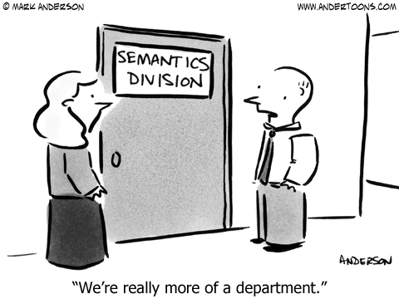
Problems/Challenges
How to transpose semantics into a machine?
Is it possible to extract semantic structures of a document?
How to group similar documents by their meaning and not only by matching words?
Documents from the same topic present similar semantic distribution?
Can we use semantic representation for document retrieval/recommendation?
How well it performs against traditional approaches?
The key point here is, semantics is not so trivial…

Slide 6
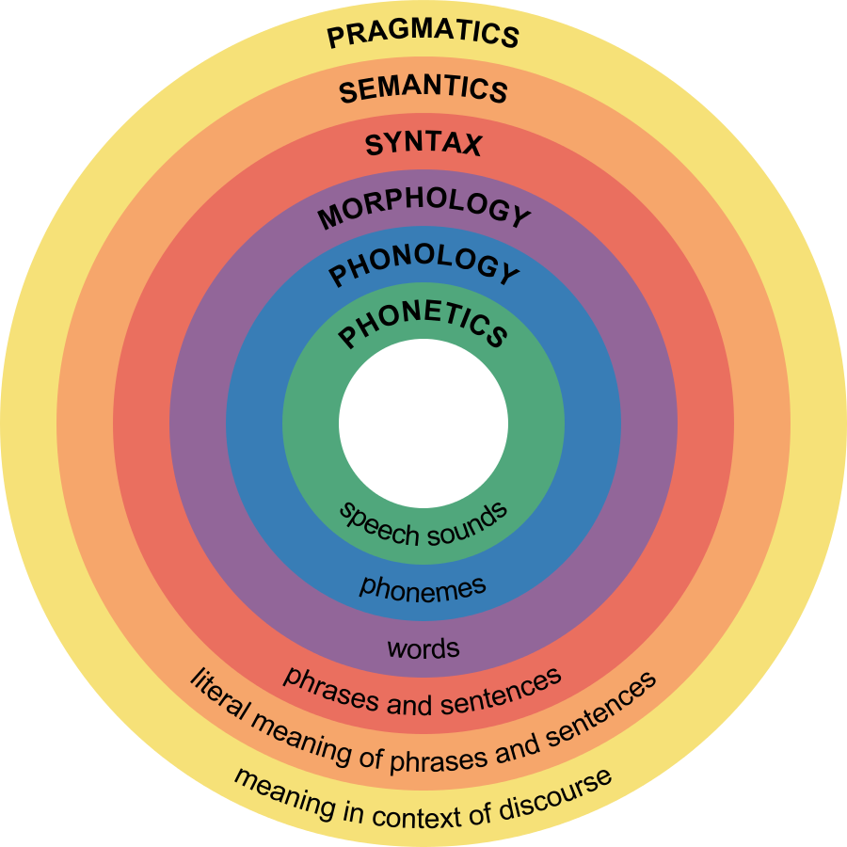
Markup language, lexical chains, topic modeling, semantic analysis, word2vec
Bag of words, count, statistical analysis, probabilistic inference, rule based system, annotated corpus/POS
https://www.boundless.com/psychology/textbooks/boundless-psychology-textbook/language-10/introduction-to-language-60/the-structure-of-language-234-12769/

Slide 7
Objectives
Develop an alternative semantic text document representation (semantic features) that can be used for document retrieval and clustering
A multilevel flexible chain representation of the extracted semantic values, which is used to construct a fixed segmentation of these chains and constituent words in the text (Flexible to Fixed Lexical Chains – F2F)
A fixed lexical chain obtained directly from the initial semantic representation from a document (Fixed Lexical Chains - FXLC)

Slide 8
Related Work
Sedding and Kazakov, 2001; Budanitsky and Hirst, 2001, 2006
AlAgha and Nafee, 2014
Morris and Hirst
Silber and McCoy
Navigli
Tekli,2016
Hotho et. al., 2003
1976
1991
1997
2000
2005
2009
2013
2015
2017
Barzilay and Elhadad
Pedersen et. al., 2004
Guo and Diab, 2011
Bär et. al.;
Wei et. al.; Pradhan et. al.
Halliday and Hassan
Ruas and Grosky
Moldovan and Novischi, 2002
Meng et. al.

Slide 9
Document Similarity/Approaches
Statistical Methods
Syntax Rules
N-gram
Bag-Of-Words (BOW)
TF-IDF
Lexical chains
Considering the first synsets/hypernym/hyponym and/or glosses
Some focus on small texts/sentences and disambiguation of words
Word embeddings
Query/Corpus expansion

Slide 10
Some Possible Solutions
Expand the query or corpora with synonyms/synsets
This is interesting, but how far will you expand? What about the context?
String Matching (N-gram, TF-IDF)
String Counting (BOW)
Probabilistic approaches
Semantics
WordNet
Word Sense Disambiguation (WSD)
Lexical Cohesion/Chains
…

Slide 11
Our Approach
Expand the notion of WSD, applied to synsets (Ruas and Grosky, 2017)
Our chains are produced by using the most suitable synset for a word
Considers the context effect
Flexible structures are transformed into Fixed ones
Fixed structures derived directly from synset representation
Our lexical chains consider hypernyms in WN, given a certain threshold (parameter)
It can be adjusted to obtain higher (more general) or lower (less general) semantic representation

Slide 12
Background
A text in which many of its sentences are semantically connected often produces a certain degree of continuity in its ideas
Provide good cohesion among its sentences.
Cohesion of ideas is more likely to occur between close words
A lexical chain is a contiguous portion of text (word or sentence) which has lexical cohesion.
Such chains are of variable length
Used for semantic characterization, for document summarization, and for clustering documents into semantic groups

Slide 13
Background
The dog and the cat run with the child and her mom in the park, this Summer
The dog and the cat run with the child and her mom in the park, this Summer
More Detail
{dog, cat, child, mom, park, summer}
{ canine, feline, juvenile, parent, tract, season }
{ carnivore, person, location, time period }
{ organism, physical entity, abstraction }
Less Detail
{entity}

Slide 14
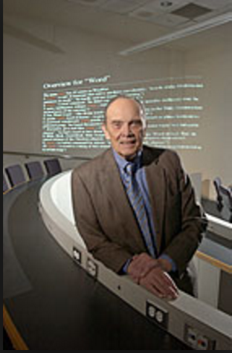
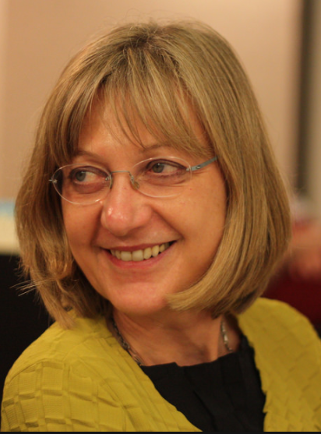
Background - WordNet
Large Lexical database of English words
Nouns, verbs, adjectives and adverbs
Organized into sets of cognitive synonyms
Synsets
Created in the Cognitive Science Laboratory of Princeton University
Professor George A. Miller starting in 1985.
Now directed by Professor Christiane Fellbaum
Over 70 different idioms
Wordnets in the World
WordNet Web
They have their own Global Association and Conferences

Slide 15
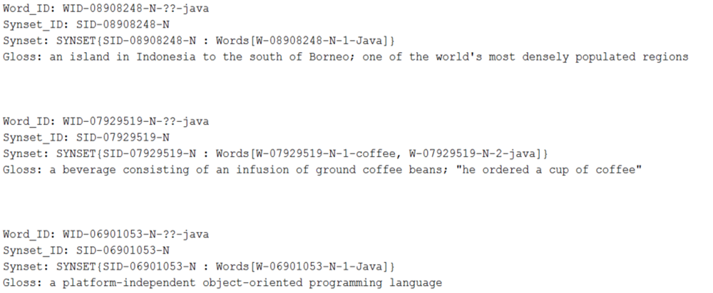
WordNet Structure - Sample

Slide 16
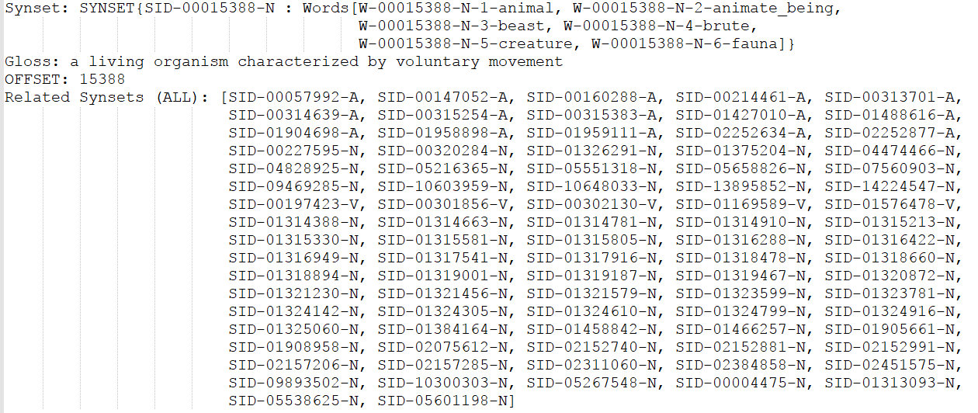
WordNet Structure

Slide 17
BTA Methodology
I. Document Extraction
II-A. Latter SID (LSID)
III-B. Flex to Fixed Lexical Chains (F2F)
IV. Distributed Semantic Mapping
II-B. Former SID (FSID)
II-C. Best SID (BSID)
III-A. Flexible Lexical Chains Extraction (FLC)
SID for Wi based on Wi+1
LSID
FSID
SID for Wi based on Wi-1
III-C. Fixed Lexical Chains Extraction
(FXLC)
Best Synset Disambiguation Module
Lexical Synset Chain Extraction Module

Slide 18
I. Document Extraction Process
Original document
i like to eat cheesecakes the best cheesecake i ever had was the strawberry cheesecake it was tiny but i liked a lot since pops bought for me i loved it
like eat cheesecake best cheesecake ever strawberry cheesecake liked since pops bought loved
I like to eat cheesecakes. The best cheesecake I’ve ever had was the Strawberry cheesecake. It was tiny, but I liked a lot since pops bought it for me. I loved it !
like eat cheese best cheese ever strawber cheese like since pop buy love
…
Data cleaning

Slide 19
II. Best Synset Disambiguation Algorithm (BSD) [Ruas and Grosky, 2017]
wi-1 wi wi+1 wi+2 wi+3 wi+4 wi+5 wi+6 wi+7
Jiang & Conrath
Wi+2
SID_21
SID_22
SID_23
…
Wi+3
SID_31
SID_32
SID_33…
Wi+4
SID_41
SID_42
SID_43
…
Jiang & Conrath
FORMER SID FSID(Wi+3)
BEST SID BSID (Wi+3)
LATTER SID LSID (Wi+3)

Slide 20
II. Best Synset Disambiguation Algorithm (BSD) [Ruas and Grosky, 2017]
If FSID(wi) and LSID(wi) are equal
BSID(wi) = FSID(wi) = LSID(wi);
The first common subsumer (hypernym) between FSID(wi) and LSID(wi), given a threshold;
If (B) produces an empty set
The deepest (more detailed) synset between FSID(wi) and LSID(wi) is chosen.
In case both have the same depth one is chosen randomly.

Slide 21
III-A. Flexible Lexical Chains Algorithm (FLC) [Ruas and Grosky, 2017]
BSID(wi-1) BSID(wi) BSID(wi+1) BSID(wi+2) BSID(wi+3) BSID(wi+4) BSID(wi+4)
If BSID(wi+4) and FLCID are equal – Incorporate BSID(wi+4)
Else, extract all hypernyms from BSID(wi+4) and FLCID, in a certain threshold
Select the first common subsumer between BSID(wi+4) and FLCID
If it exists, incorporate BSID(wi+4) to the chain and update FLCID
Else, BSID(wi+4) and FLCID are not semantically related, so a new chain must be created

Slide 22
III-B. Flexible to Fixed Lexical Chains Conversion (F2F)
S1 S2 S3 S4 S2 S1 S2 S1
S1 S1 S1 S2 S3 S4 S4 S4 S4 S2 S1 S2 S2 S1
wi wi+1 wi+2 wi+3 wi+4 wi+5 wi+6 wi+7 wi+8 wi+9 wi+10 wi+11 wi+12 wi+13
S1 S4 S2 Sn
wi wi+1 wi+2 wi+3 wi+4 wi+5 wi+6 wi+7 wi+8 wi+9 wi+10 wi+11 wi+12 wi+13

Slide 23
III-C. Fixed Lexical Chain Algorithm (FXLC)
wi wi+1 wi+2 wi+3 wi+4 wi+5 wi+6 wi+7 wi+8 wi+9 wi+10 wi+11 wi+12 wi+13 wi+14…
Sx Sy Sx Sy
Extract all synsets/hypernyms from each Ci (for each BSID(wj))
Select the dominant synset to represent Ci (within a threshold)
If no dominant synset is found, pick the deepest (more detailed) one
If there is more than one synset, select one randomly

Slide 24
Semantic Distribution Mapping
Distance between same synsets is considered (I)
Synsets occurring only once present a problem
Do not have distance between themselves
The first synset in a sequence is also “not considered”
Solution
Increment for zero distance on single synset occurrences (II)
Increment for zero distance for first synset in any sequence of occurrences (III)

Slide 25
IV. Semantic Distribution Mapping
Map Type | Sequence of Synsets | Raw Distances | 4-Bin Histogram Representation
I | S₁S₂S₂S₄S₂S₃S₁ | S₁<6>S₂<1,2>S₃<>S₄<> | <0,0,0,1>|<1,1,0,0>|<0,0,0,0>|<0,0,0,0>
II | S₁S₂S₂S₄S₂S₃S₁ | S₁<6>S₂<1,2>S₃<0>S₄<0> | <0,0,0,1>|<1,1,0,0>|<1,0,0,0>|<1,0,0,0>
III | S₁S₂S₂S₄S₂S₃S₁ | S₁<0,6>S₂<0,1,2>S₃<0>S₄<0> | <1,0,0,1>|<2,1,0,0>|<1,0,0,0>|<1,0,0,0>

Slide 26
IV. Semantic Distribution Mapping
We characterize the dispersion (spatial distribution) of synsets
Use the distances between Lexical Chains (with a common ID) to build a histogram
Semantic structure
Document length independent
The granularity of their location in the text depends the number of bins (e.g. 8, 16, 32, 64, 128, 256)
The higher the number of bins, the higher its granularity
The lower the number of bins, the lower its granularity

Slide 27
Experiments – Proof of Concept (POC)
Wikipedia Category | Number of Documents | Number of Words | Nouns Matched in WN | Avg. of Nouns in WN (%)
Dogs | 10 | 48,650 | 16,239 | 34.37
Computers | 10 | 79,332 | 24,331 | 31.11
Sports | 10 | 88,532 | 28,266 | 32.38
Total | 30 | 216,514 | 68,836 | 32.62

Slide 28
Adjusted Rand Index and Mean Individual Silhouette
Spherical k-Means Clustering
Popular method for clustering high-dimensional text data
Uses the cosine distance rather than Euclidean distance
Adjusted Rand Index
Measure of similarity between two clusters
Compares the derived clusters to the ground truth clusters
Mean Individual Silhouette
Measures how well the clusters are designed
Verifies if documents in the same cluster are close together, while documents in different clusters are far apart
Notes:
Why these metrics an not others? Let’s exercise questions like these

Slide 29
Adjusted Rand Index and Mean Individual Silhouette
Label | Algorithm | Adjusted Rand Index | Mean Individual Silhouette
A | Pure Flex--Method III | 1 | 0.1908
B | Pure Flex--Method II | 1 | 0.1775
C | BOW-N--Nouns in Wordnet | 1 | 0.1757
D | BOW-B--Best Synsets | 1 | 0.1686
E | Flex-2-Fixed--Method I | 0.8981704 | 0.3964
F | Flex-2-Fixed--Method III | 0.8981704 | 0.3878
G | BOW-R--Raw Words | 0.8981704 | 0.1591
H | Flex-2-Fixed--Method II | 0.8066667 | 0.3578
I | BOW-S--WordNet First Synset | 0.6671449 | 0.1542
J | Pure Flex--Method I | 0.6590742 | 0.1826
K | Pure Fixed--Method I | 0.6044735 | 0.2137
L | Pure Fixed--Method III | 0.5165853 | 0.2734
M | Pure Fixed--Method III | 0.40252 | 0.2743

Slide 30
Mean Individual Silhouette and Adjusted Rand Index

Slide 31
Discussions
Three out of the four results with perfect clustering are from our techniques
Two of these perfect clustering’s use FLC
One use BSD applied to BOW
FLC-III (A) is the only perfect clustering result which is on the Pareto front (not dominated by any other result)
F2F-I (E) presents the clustering with the maximum silhouette value
This clustering is also on the Pareto front
All clustering's in the Pareto Front use our techniques

Slide 32
Contributions
Explored how to extract semantic features via Lexical Chains
Flexible to Fixed Lexical Chain (F2F)
Fixed Lexical Chains (FXLC)
BOW + Applying BSD
BOW + Applying First Synset
Proof of Concept (POC)
Dataset public available at https://doi.org/10.7302/Z26W980B
(Algorithm details) Technical report available at http://dx.doi.org/10.3998/2027.42/136659

Slide 33
Future Work
More robust semantic representation
Explore Lexical Chains/Semantic features
Effects of different WSD algorithms in the BSD algorithm
Wu & Palmer, Leacock, Lin, Tversky, Zhou, Leacock & Chodorow, Resnik, Li, Agirre, etc
Incorporate word embedding techniques in our approaches
Apply proposed techniques in other areas, such as Scientific Paper Mining and Recommendation
Use semantic features to mine, relate and suggest scientific papers based on their semantic content

Slide 35
Contacts
​Personal Website: https://ruasterry.wordpress.com/
Research Gate: https://www.researchgate.net/profile/Terry_Ruas
Linkedin: https://www.linkedin.com/in/terryruas/
Lattes: http://lattes.cnpq.br/5778464496028105
Email: truas@umich.edu
Personal Website: https://wgrosky.wixsite.com/mysite
Research Gate: https://www.researchgate.net/profile/William_Grosky
Linkedin: https://www.linkedin.com/in/william-grosky-6aba6a/
Email: wgrosky@umich.edu

